Slide 1
FYP5: Object Detection, Tracking and Suspicious Activity Recognition for Maritime Surveillance using Thermal Vision

Slide 2
Weekly Tasks
Object Detection
To detect objects using transfer learning in Thermal Images provided by FLIR Dataset.
To detect objects by training object detection models from scratch.
Literature Review on Activity Recognition
Statistical Models
Literature Review on Suspicious Activity Identification
Stabilization
Mechanical stabilization
Digital Video stabilization

Slide 3
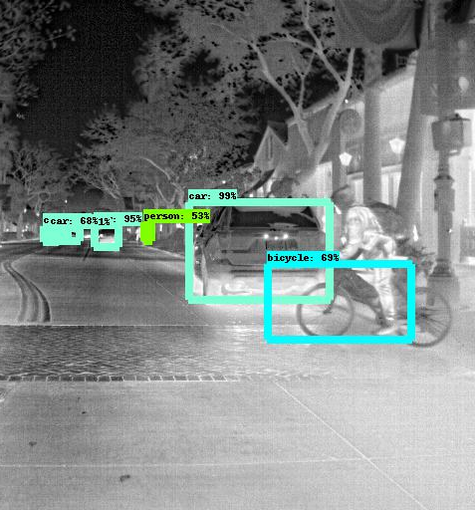
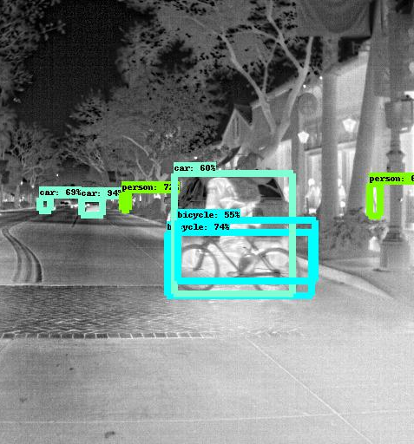
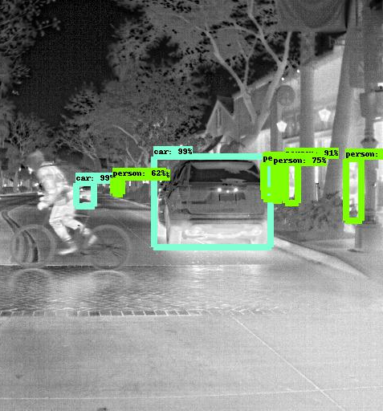
Object Detection – Transfer Learning FRCN

Slide 4
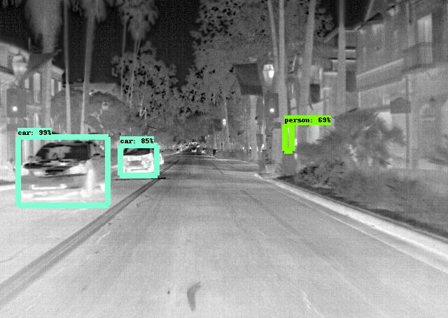
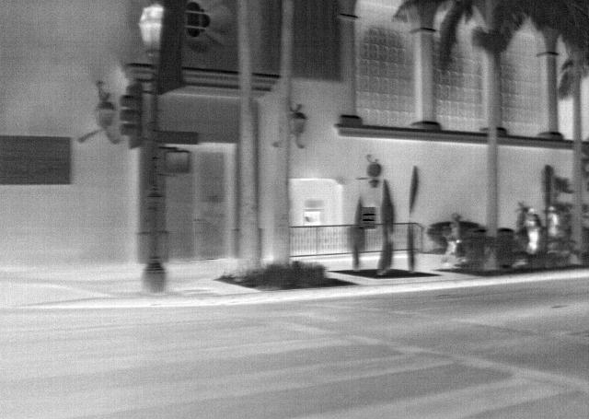
Object Detection – Transfer Learning SSD

Slide 5
Literature Review – Activity Recognition
Human Activity Recognition in Thermal Infrared Imagery - Computer Vision and Pattern Recognition, 2005
Human motion detection and silhouette extraction, Spatiotemporal representation, Gait Energy Image (GEI) for repetitive activity recognition, Statistical approach to extract features from GEI for activity recognition.
Why use GEI? – GEI targets specific repetitive activity representation. Also GEI is less sensitive to silhouette noise in individual frames.
FLIR Long Range camera
Thermal image analysis for anxiety detection – Image Processing, IEEE International Conference 2001

Slide 6
Mechanical Stabilization
Works for long range images where digital stabilization fails.
A vessel on the open ocean will experience a lot of movement, but again that movement is a different type than what would be experienced on a tower or off-road vehicle. Cameras mounted to marine vessels require different levels of gyro stabilization depending on the size of the vessel and the camera’s field of view.

Slide 7

Digital Video Stabilization 1. Video Stabilization Using Point Feature Matching
Pros:
This method provides exceptionally good stability against low-frequency jitteriness(slower vibrations).
This method can process in real-time and thus ideal for real-time applications.
This method is good against zooming(scaling) jitter in the video.
Cons:
This method performed poorly against high-frequency vibrations.
This method is also not good with Rolling Shutter distortions.

Slide 8
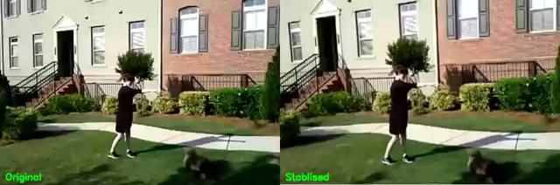
Digital Video Stabilization 2. MeshFlow Controlled Video Stabilization
Pros:
This method provide excellent stability against high-frequency perturbations and Rolling Shutter distortions.
This method performed exceptionally well against low-quality video footage
This method highly robust to the different type of camera motions and scene types.
Cons:
This method requires very high computational power to work
This method is also non-ideal for real-time performance

Slide 9

Tasks for next week
Continuation of the object detection model
POC level of horizon detection
Go through mechanical stabilization – ISP
Literature review of Suspicious Activity Recognition
Contact FLIR regarding thermal dataset

